Slide 1
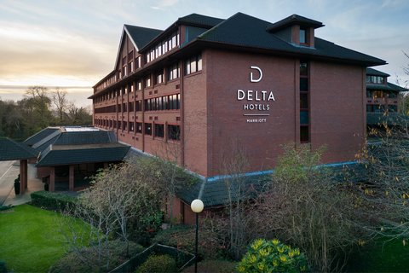
Delta Hotels by Marriott Swindon

Slide 2
Zero Food Waste
Annual Report 2024

Slide 3
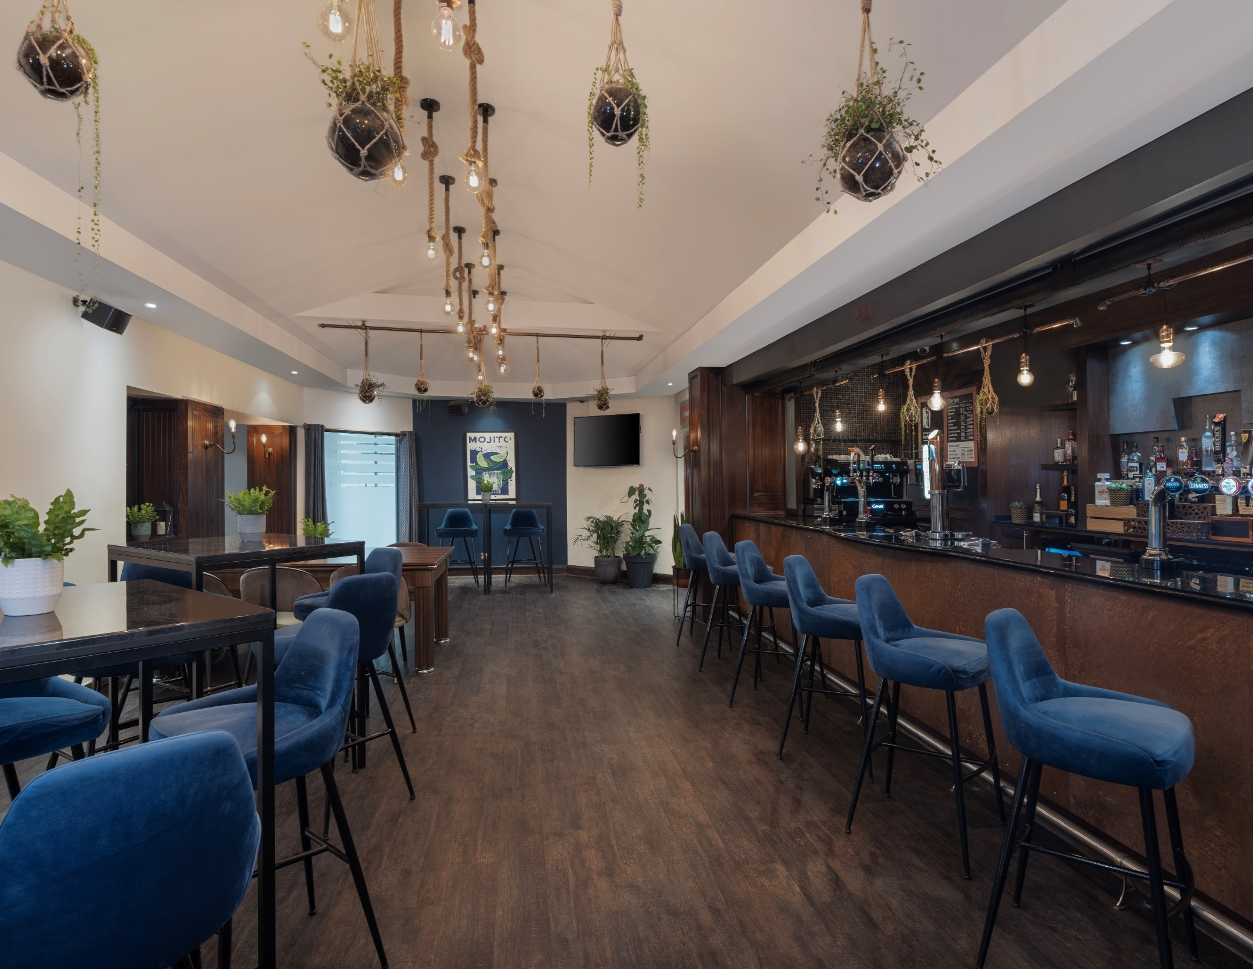
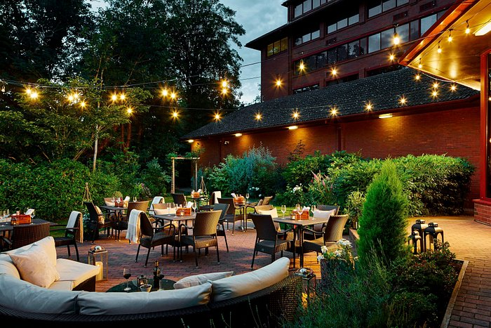
Our Mission
TO REDUCE FOOD WASTE
HERE AT DELTA HOTELS BY MARRIOTT SWINDON, WE HAVE PARTNERED WITH THE PLEDGE ON FOOD WASTE TO MAKE AN IMPACT ON FOOD WASTE.
AS A HOTEL THAT PROVIDES A LARGE VOLUME OF FOOD & BEVERAGE SERVICES, WE ARE COMMITTED TO TAKING THOUGHTFUL ACTION TO COMBAT FOOD WASTEAND TO DO OUR PART - SOCIALLY, ENVIRONMENTALLY AND FINANCIALLY

Slide 4
FOOD LOVERS COMMITTEE
Rafal Kowalczyk
Hotel Manager
Philip Pereira
Food & Beverage Manager
Bogdan Barbu
Head Chef
Daniel Massarella
Human Resources Manager
Antonio Fernandes
Maintenance Supervisor
Nick Gatirima
Food & Beverage Supervisor
Shrijana Purja
Finance Assistant/ C&B Supervisor
Neha Shyji Sreejayan
Human Resources Officer

Slide 5
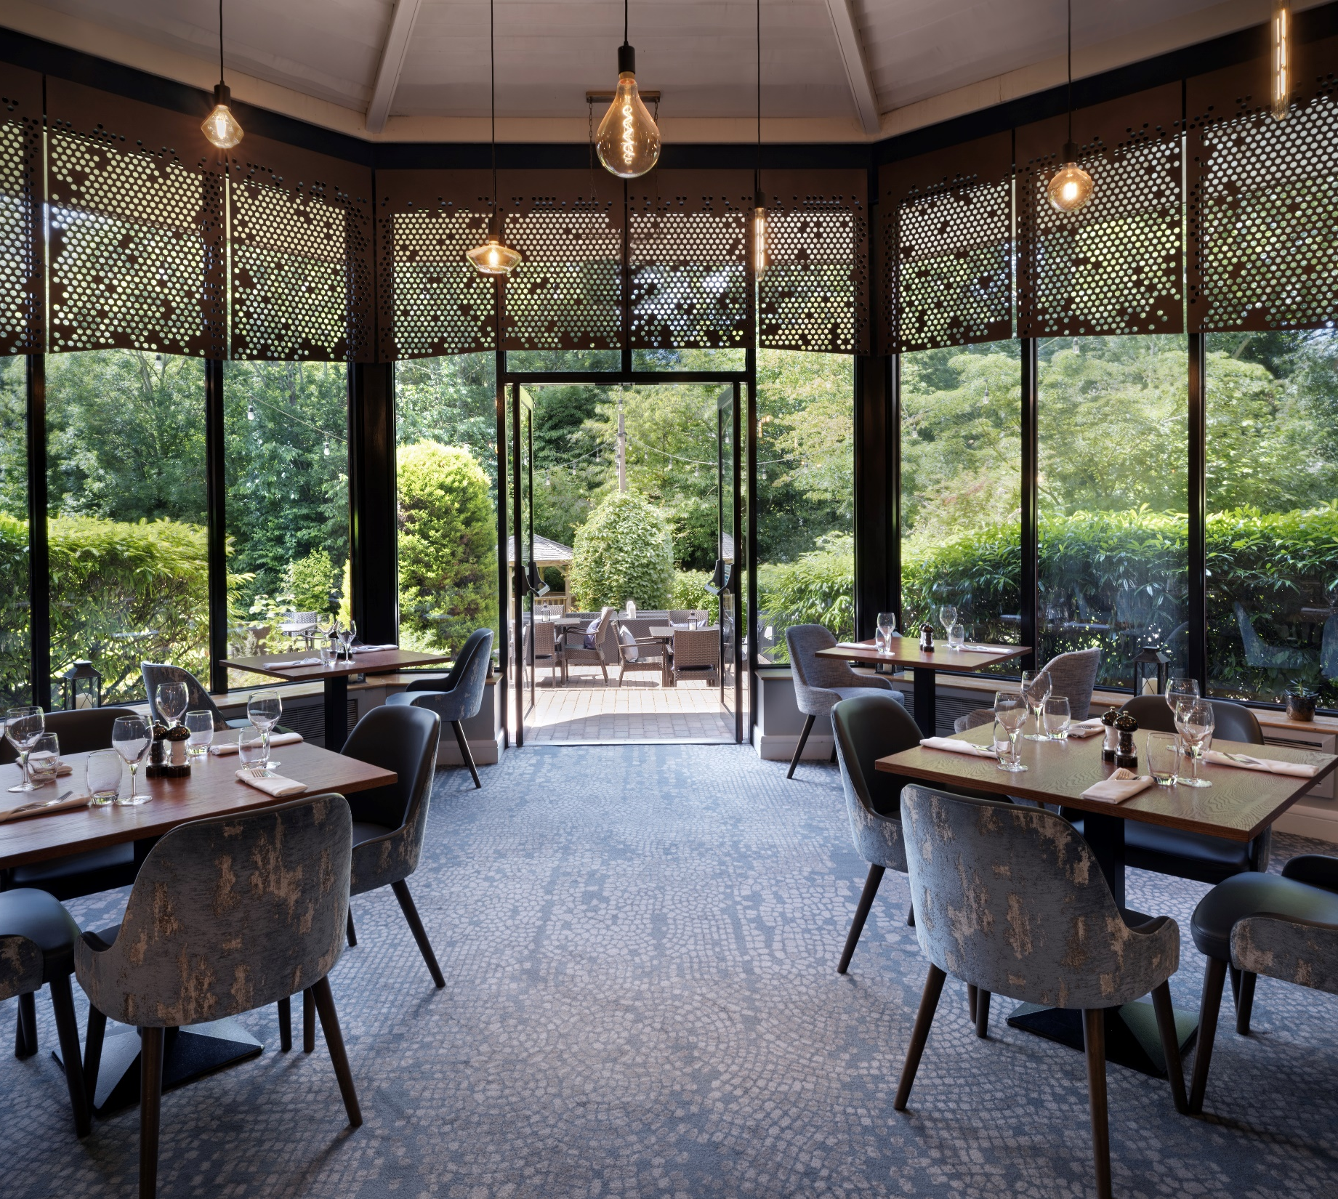
Food Waste Policy
Marriott UKI and Nordics affirms its commitment to operate as a responsible business, to reduce its impact on the environment and to adopt sustainable practices by embracing The PLEDGE™ on Food Waste Certification.
Marriott UKI and Nordics acknowledges the importance of environmental sustainability and is concerned about its “Food Print”. Thus, Marriott UKI and Nordics is committed to creating a food waste conscious environment within its operations and will partake in The PLEDGE™ on Food Waste Certification.
Associate commitment, consistently measuring food waste, integrating new SOPs, engaging diners and implementing circular models are challenges that we are aware of. However, Marriott UKI and Nordics is committed to deal with these issues and will design, then implement an effective action plan.
Marriott UKI & Nordics
Food Waste Reduction Policy
February 2024
Delta Hotels By Marriott Swindon

Slide 6
Marriott UKI and Nordics genuinely commits to preventing food waste by complying with the 7 pillars that The PLEDGE™ on Food Waste evolves around:
Envisioning the path to take, planning actions to minimize food waste and reporting the result to the internal and external community.
Engaging the whole team and establishing a Food Lover’s Committee that aims to raise awareness by conducting regular trainings and meetings.
Installing a food waste monitoring system that tracks, records and compares food waste. The data is analysed and action is taken accordingly.
Implementing, reviewing and improving the processes and policies to minimize food waste.
Improving and implementing the best practices to reduce food waste in the kitchen operations.
Inspiring the customers by regularly communicating about sustainable food waste practices that are in place.
Adopting circular solutions such as redistributing and/or transforming food leftovers.
Delta by Marriott Swindon
Rafal Kowalczyk
Bogdan Barbu
Philip Pereira
Marriott UKI & Nordics
Food Waste Reduction Policy
February 2024
Delta Hotels By Marriott Swindon

Slide 7
The Participating Venue

Slide 8
FOOD WASTE
KG & CO2
REPORT
Year 2024 | Weight in Kg | C02
January Baseline 29th -4th Feb | 1426 | 432
February | N/A | N/A
March | 1374 | 5907
April | 1205 | 5183
May | 1029 | 4427

Slide 9
FOOD SAVING
KG & CO2
REPORT
Year 2024 | Weight in Kg | C02
February | N/A | N/A
March | 66 | 285
April | 131 | 563
May | 418 | 1798

Slide 10
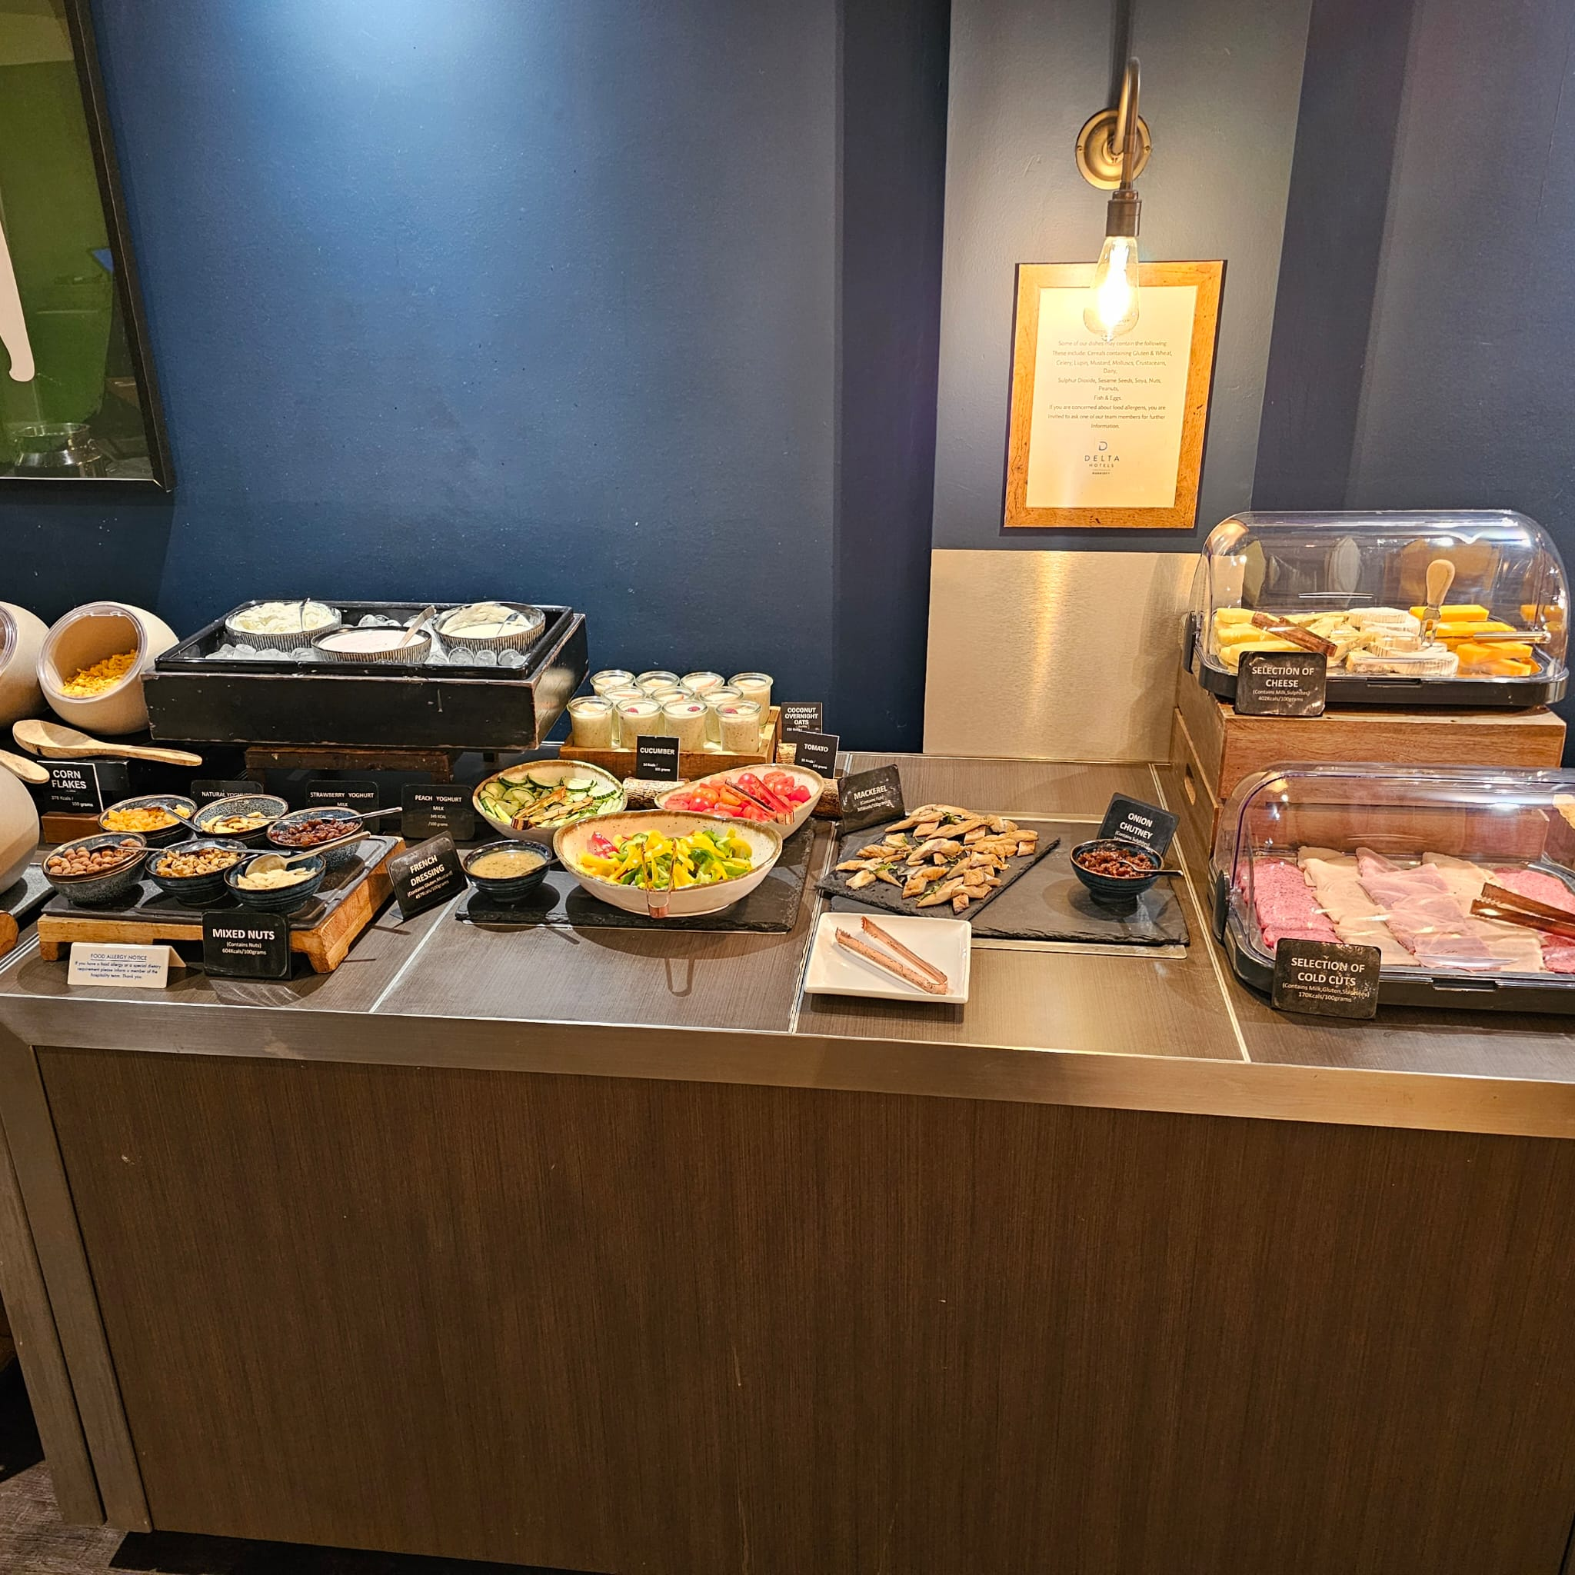
Food & Beverage

Slide 11
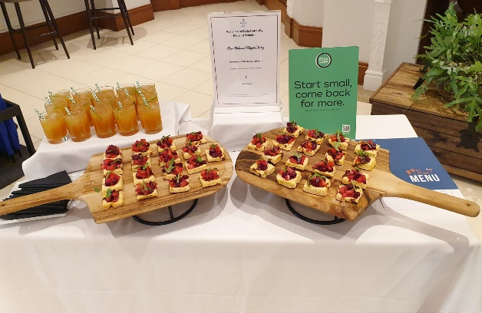
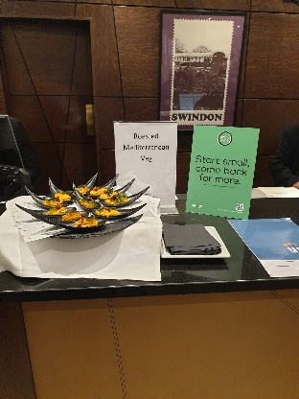
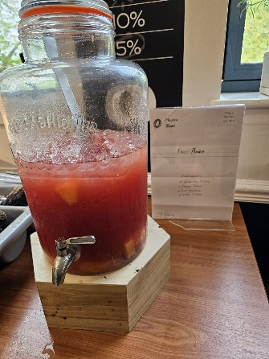
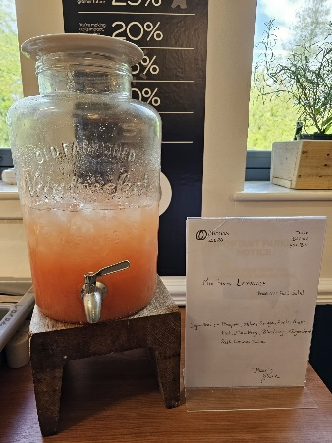
Zero Food Waste
Activations
Customer Engagement
Reused cut fruits to prepare refreshing drinks
Competitions for associates to achieve the goal of Zero Food Waste

Slide 12
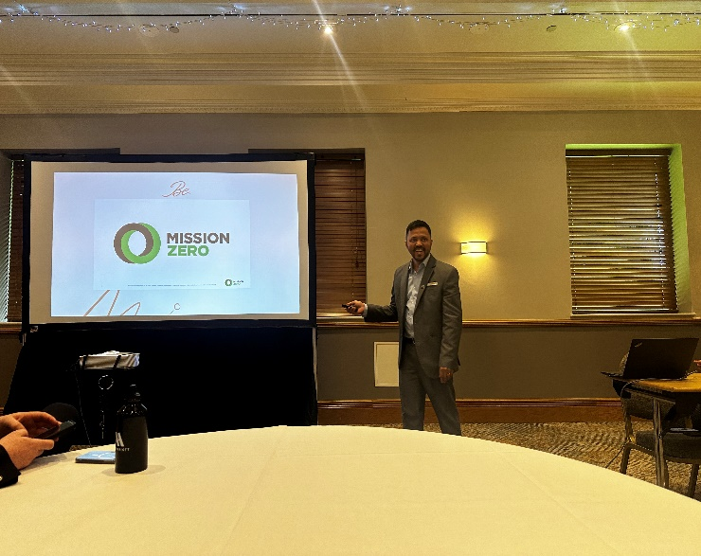
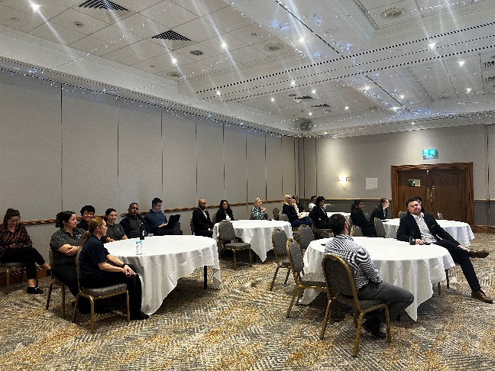
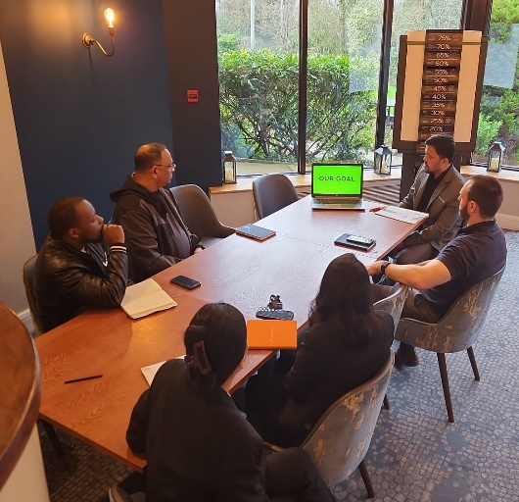
Zero Food Waste Education
ASSOCIATE COMMITMENT, CONSISTENTLY MEASURING FOOD WASTE, INTEGRATING NEW SOPS, ENGAGING DINERS AND IMPLEMENTING CIRCULAR MODELS ARE CHALLENGES THAT WE ARE AWARE OF. HOWEVER, MARRIOTT UKI AND NORDICS IS COMMITTED TO DEAL WITH THESE ISSUES AND WILL DESIGN, THEN IMPLEMENT AN EFFECTIVE ACTION PLAN ALONG WITH CONTINUED TRAINING AND EDUCATION

Slide 13
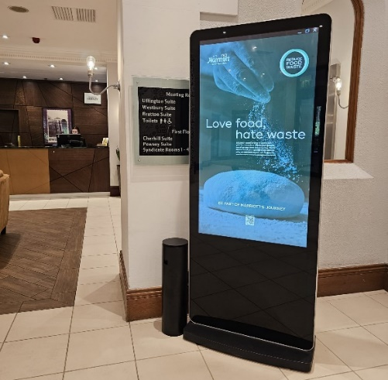
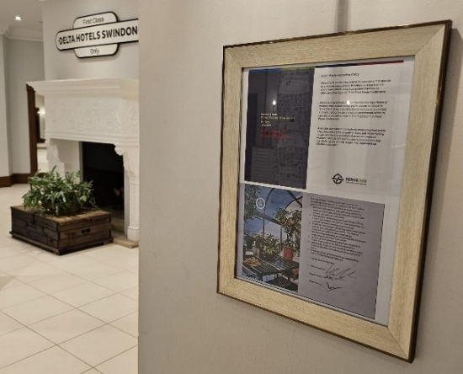
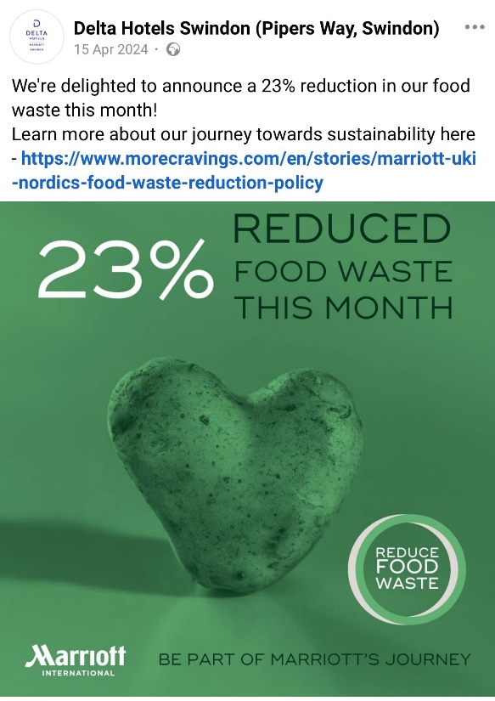
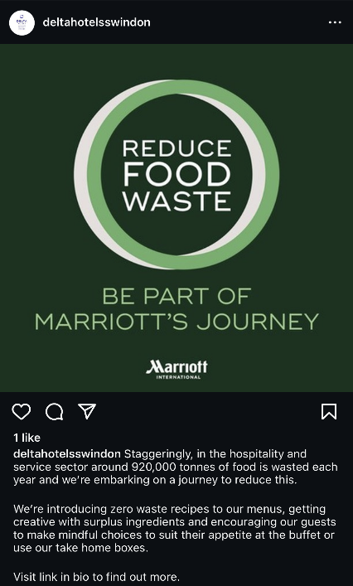
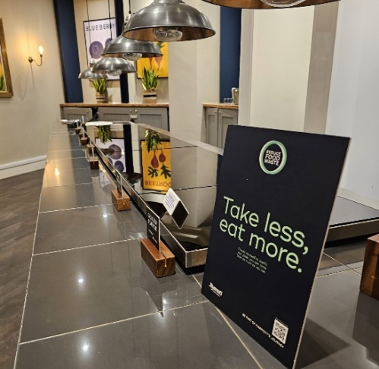
Zero Food Waste
Guest Awareness
Guest Posters
Social Media

Slide 14
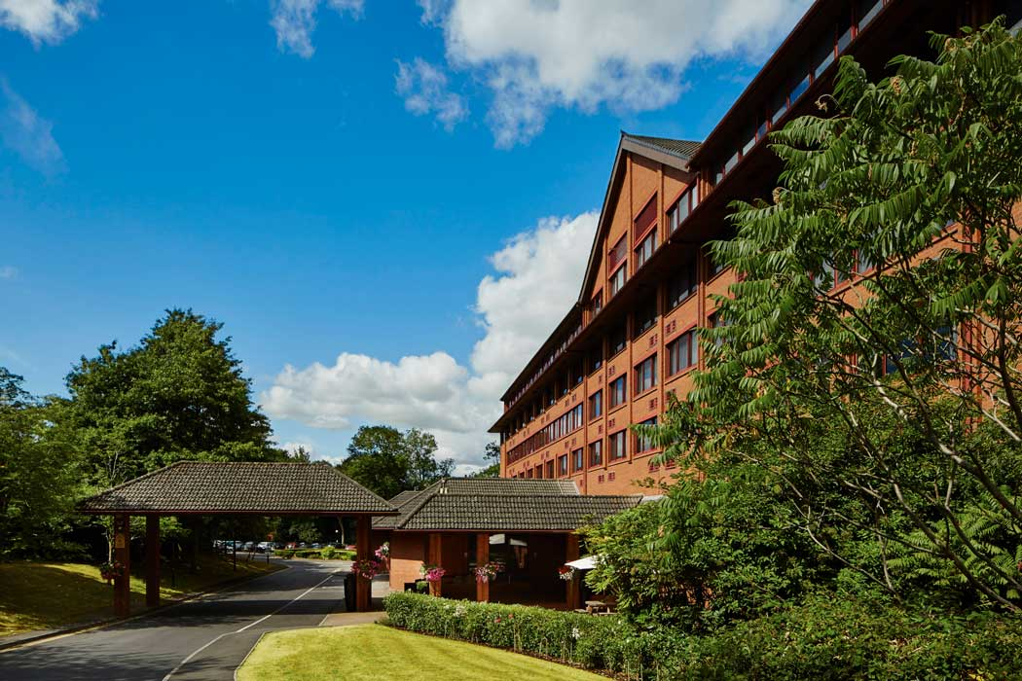
Thank You

